Slide 1
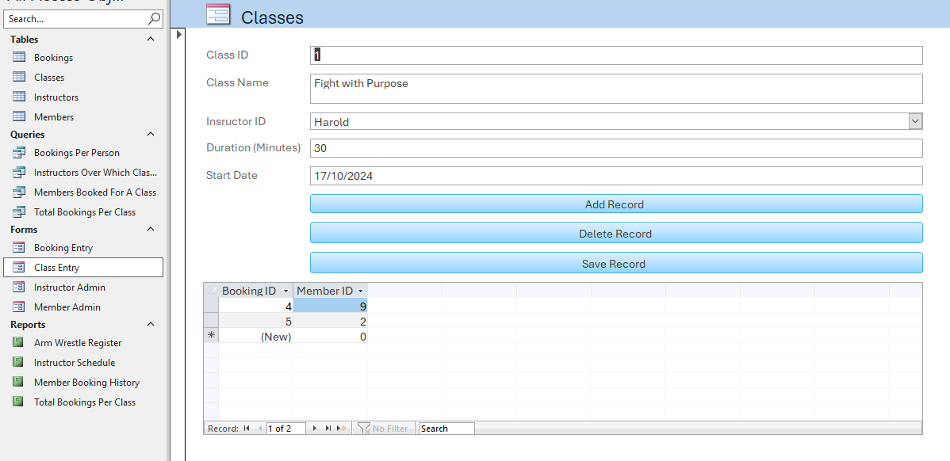
Access Portfolio Project
An Overview into the process

Slide 2
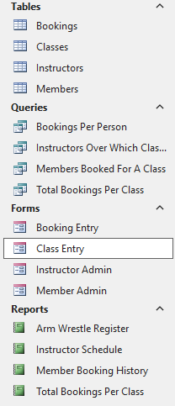
Project Summary
Microsoft Access provides an opportunity to create a more user-friendly way of managing, querying and adding new entries to databases. Comprised of four different objects (Tables, Forms, Queries and Reports), the traditional methods of document keeping have made way to a far more efficient and risk-averse method of data entry and storage.
My aim is to construct a simple yet comprehensive database using all four of these objects to run a gym’s database, allowing information to be managed, allowing employees to add entries, retrieve specific information through queries and visualise it through reports.

Slide 3
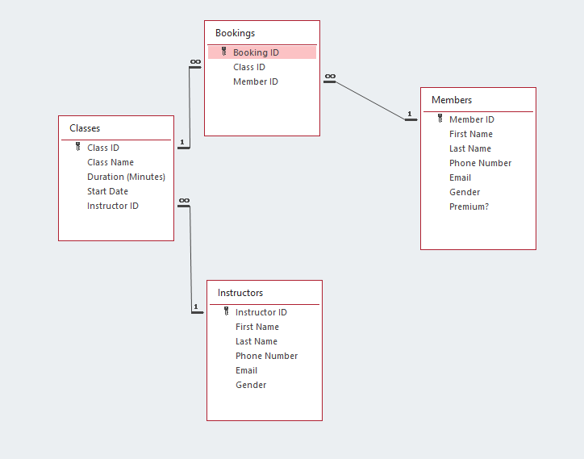
The Schema
I have constructed four tables and connected them together in this star schema. I intend for employees to be able to access forms to add records to each of the three dimensional tables (Members, Instructors, Classes) and also to the fact table (Bookings) that combines the foreign keys from the other tables to create a definitive booking record.

Slide 4
The Schema
Members: This table allows users to administrate member details including their name and contact details, amending or deleting them when needed through a simple form. Simple, but very important.
Classes: This table allows users to set up classes to be booked, denoting their duration and the date of the booking. As time progresses, they can book more classes and begin to compare between them to see which ones were the most successful. This table has a foreign key linked to the instructor table to show who is teaching this class. If the instructor in charge of the class falls ill, the class can have a new member slotted in that updates all current bookings with that class.

Slide 5
The Schema
Instructors: This table is very similar to the members table, though this dimension is important as this allows classes to be made with one of these instructors hosting it.
Booking: This fact table combines all the dimensional tables together to book a specific member with a specific class taught by a specific instructor. Using combo-boxes in the respective form, this process goes from irritating and inefficient to easy and streamlined.

Slide 6
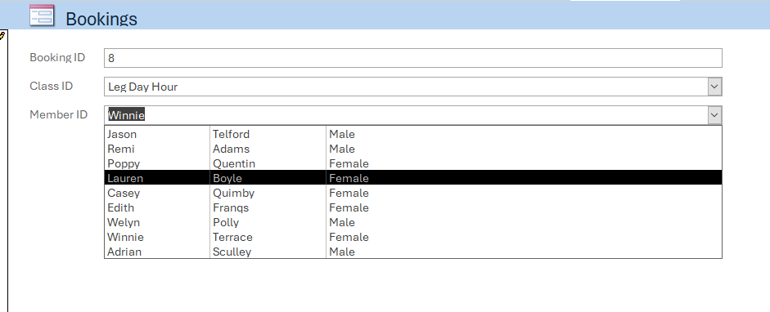
User-Friendly Forms
A very important part of constructing user-friendly forms is finding a way to turn fields like the Instructor ID foreign key in the classes field to something the user can understand; combo-boxes are absolutely the fastest way to do this, referring to fields of your choosing from where the foreign key originated from. This allows the user to choose the instructor ID through the names of the instructor instead of having to memorise the ID of every instructor. Combined with buttons to add new records, save record and delete records, the users have everything they need to modify their database as and when needed.

Slide 7
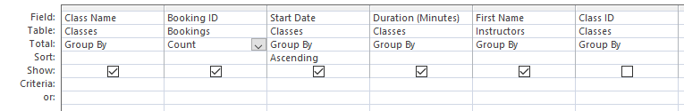
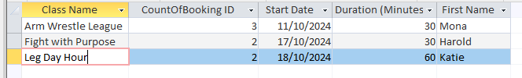
Attendance Query
The relationships we defined allow us to run queries on a lot of important parts of the data, such as the attendance rate of classes. By adding a ‘totals’ row in our query editor, we can see the ‘count’ of bookings per class.

Slide 8
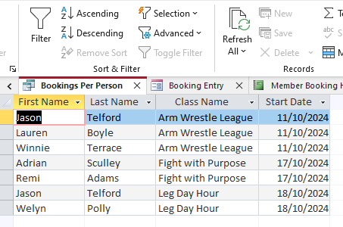


Member Bookings Query
This query looks at the bookings made by every member. By selecting a name and clicking ‘selection’ in the ribbon we can set a filter to see exclusively bookings from this one person.

Slide 9
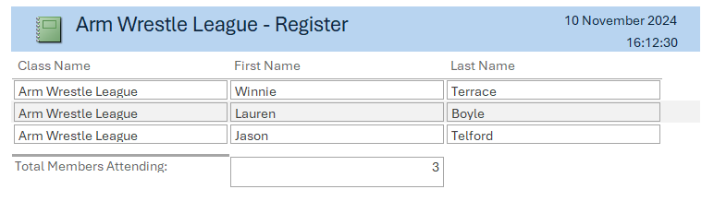
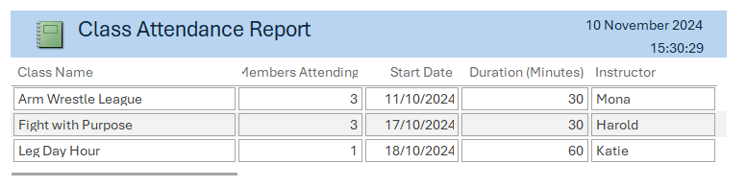
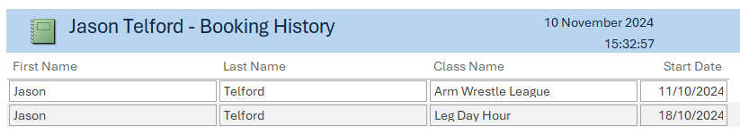
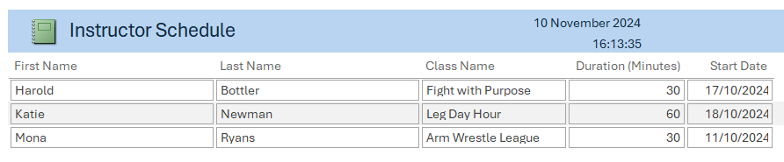
Queries to Reports
With the ability to filter the data that we want, we can directly create reports that highlight them in an easily digestible format.

Slide 10
What I’d do differently
I would continue to make the forms more presentable and user friendly through various means. The tables could also do with some new values, such as a customer’s sign-up date we can use to run queries on long-standing members. For example, we could push a marketing campaign for non-premium users to upgrade if they have been signed up for longer than six months. I could also use the forms I have created to add more records to show my queries working in a larger dataset.
The bigger the dataset gets, the harder it could be to use combo-boxes to find specific members, so I could figure out how to create a search function.

